Slide 1



Do not edit
How to change the design
Join at slido.com #4178747
Presenting with animations, GIFs or speaker notes? Enable our Chrome extension
Notes:
📣 This is Slido interaction slide, please don't delete it. ✅ Click on 'Present with Slido' and the joining instructions will appear when you get to this slide.

Slide 2

Do not edit
How to change the design
What is Infrastructure as a Code (IaC)? Give an example.
Presenting with animations, GIFs or speaker notes? Enable our Chrome extension
Notes:
📣 This is Slido interaction slide, please don't delete it. ✅ Click on 'Present with Slido' and the poll will launch automatically when you get to this slide.

Slide 3
Quiz 3 Topics
22. AWS Security: KMS, WAF, and Shield
23. Capacity Planning & Cloud Brokers
24. Service-Level Agreements (SLAs) in Cloud Computing
25. CI_CD_ Streamlining Software Delivery
26. Serverless Computing
27. IAC(Cloudformation), Monitoring & Logging

Slide 4

Do not edit
How to change the design
What is your Quiz 2 experience?
Presenting with animations, GIFs or speaker notes? Enable our Chrome extension
Notes:
📣 This is Slido interaction slide, please don't delete it. ✅ Click on 'Present with Slido' and the poll will launch automatically when you get to this slide.

Slide 5
AWS Budget and Cost Optimisation
Cost Optimization & Budgeting Tools - Pricing Calculator

Slide 6

Introduction to Cost Optimization & Budgeting Tools
Cost Optimization in AWS focuses on minimizing expenses while maintaining performance and security.
Key Factors:
Right-Sizing Resources
Choosing the Right Pricing Model (On-demand, Reserved Instances, Spot Instances)
Monitoring and Automation
AWS Budgets

Slide 7
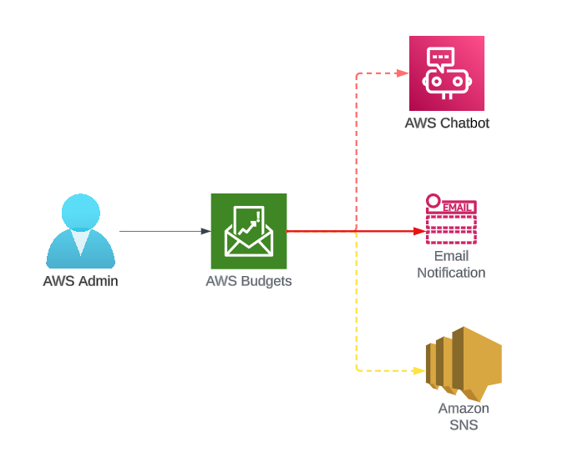

Slide 8
Do not edit
How to change the design
Which of the following is NOT a key factor in AWS cost optimization?
Presenting with animations, GIFs or speaker notes? Enable our Chrome extension
Notes:
📣 This is Slido interaction slide, please don't delete it. ✅ Click on 'Present with Slido' and the poll will launch automatically when you get to this slide.

Slide 9
AWS Pricing Models Overview
On-Demand Instances: Pay-as-you-go.
Reserved Instances: 1 to 3-year commitment for discounted pricing.
Spot Instances: Up to 90% discount but can be interrupted.
Savings Plans: Flexible pricing for consistent usage.

Slide 10
Do not edit
How to change the design
Which AWS pricing model provides the highest discount but with the risk of interruption?
Presenting with animations, GIFs or speaker notes? Enable our Chrome extension
Notes:
📣 This is Slido interaction slide, please don't delete it. ✅ Click on 'Present with Slido' and the poll will launch automatically when you get to this slide.

Slide 11
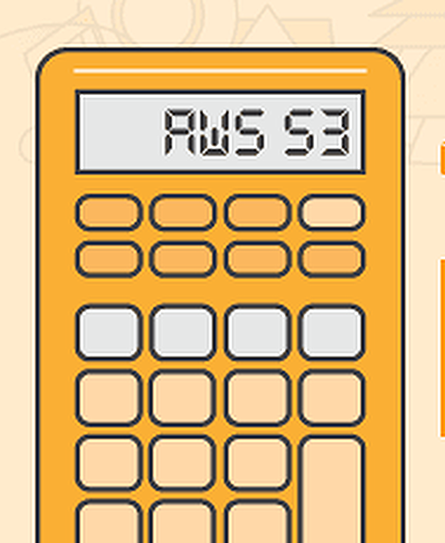
What is AWS Pricing Calculator?
A tool to estimate AWS service costs.
Helps in planning and forecasting.
Supports all major AWS services.
URL:
https://calculator.aws/

Slide 12
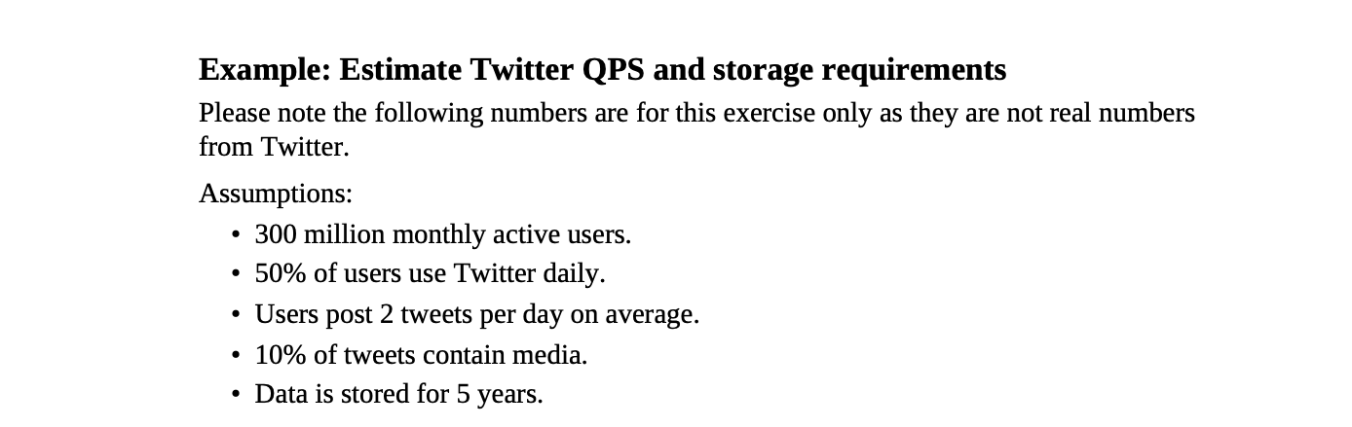
Find the QPS and Storage Requirement

Slide 13
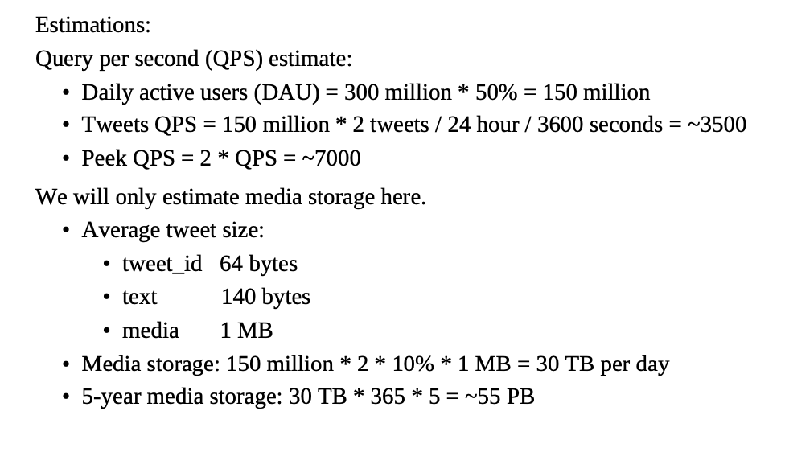
Solution:

Slide 14
Do not edit
How to change the design
What is the primary purpose of AWS Pricing Calculator?
Presenting with animations, GIFs or speaker notes? Enable our Chrome extension
Notes:
📣 This is Slido interaction slide, please don't delete it. ✅ Click on 'Present with Slido' and the poll will launch automatically when you get to this slide.

Slide 15
Key Features of AWS Pricing Calculator
Detailed Estimates: Resource-level cost breakdown.
Export and Share Estimates.
Customization: Customize pricing based on regions, storage, data transfer, etc.
Savings Estimates: Compare On-Demand vs Reserved pricing.

Slide 16
Do not edit
How to change the design
Which of the following is NOT a feature of AWS Pricing Calculator?
Presenting with animations, GIFs or speaker notes? Enable our Chrome extension
Notes:
📣 This is Slido interaction slide, please don't delete it. ✅ Click on 'Present with Slido' and the poll will launch automatically when you get to this slide.

Slide 17
Using AWS Pricing Calculator – Step-by-Step
Choose Services – Select EC2, S3, RDS, etc.
Configure Requirements – Instance type, storage, region.
Estimate Costs – Check pricing breakdown.
Compare Pricing Models – On-demand vs Reserved.
Export & Share Report.

Slide 18
Do not edit
How to change the design
Which is the first step when using AWS Pricing Calculator?
Presenting with animations, GIFs or speaker notes? Enable our Chrome extension
Notes:
📣 This is Slido interaction slide, please don't delete it. ✅ Click on 'Present with Slido' and the poll will launch automatically when you get to this slide.

Slide 19
AWS Budgets Tool
What is AWS Budgets?
Set custom cost and usage budgets.
Receive alerts via email or SNS.
Track actual vs forecasted spend.
Supports: Service, Linked Accounts, Tags.
AWS Budgets

Slide 20
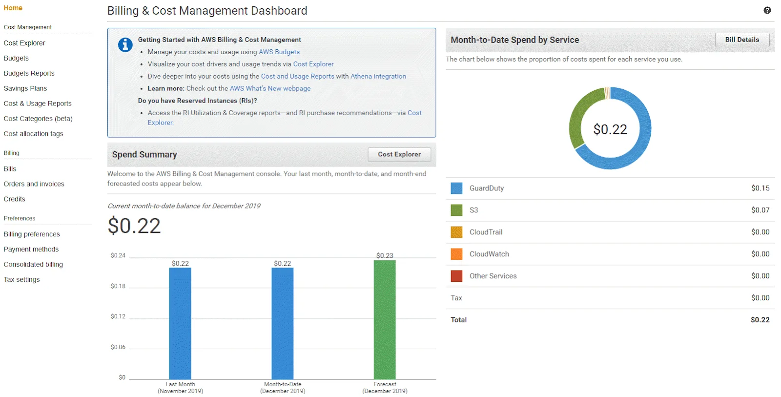

Slide 21
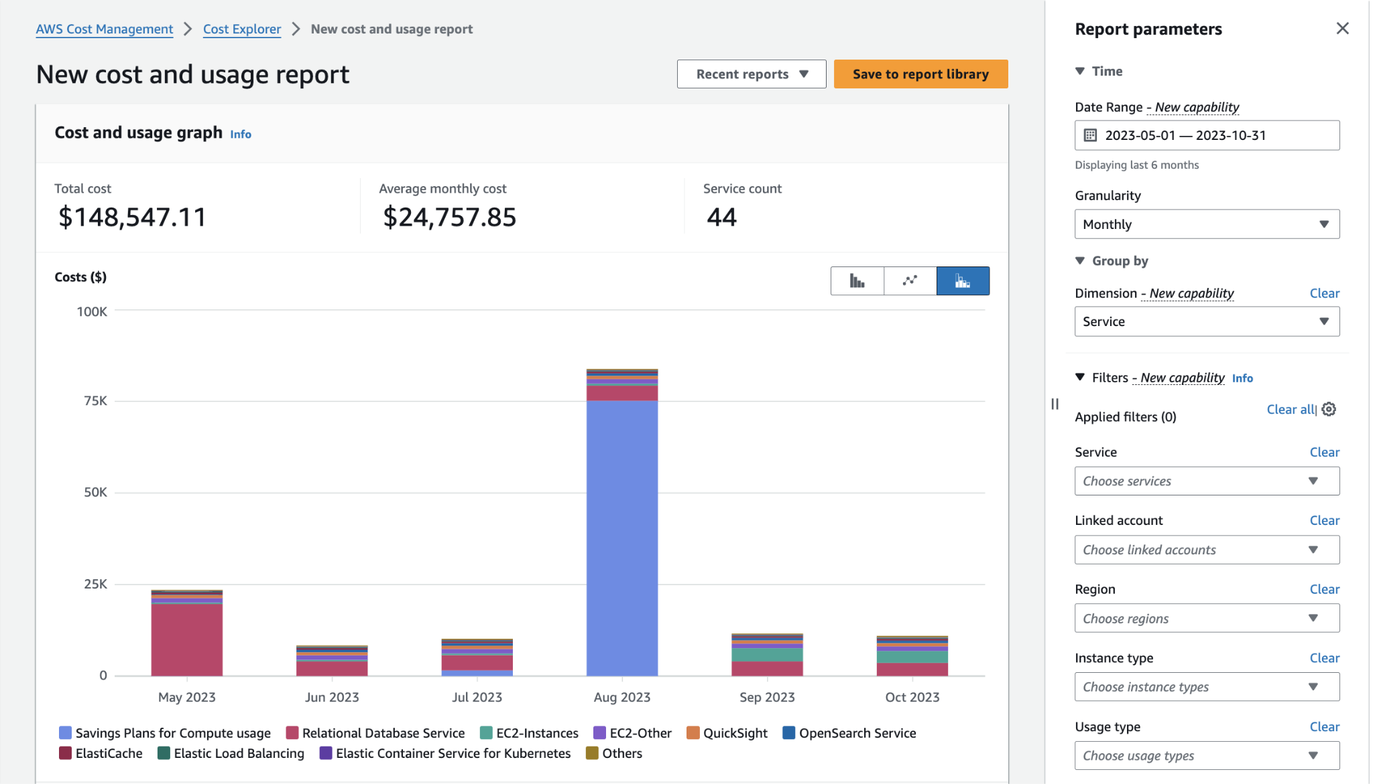

Slide 22
Do not edit
How to change the design
What can AWS Budgets NOT alert you about?
Presenting with animations, GIFs or speaker notes? Enable our Chrome extension
Notes:
📣 This is Slido interaction slide, please don't delete it. ✅ Click on 'Present with Slido' and the poll will launch automatically when you get to this slide.

Slide 23
AWS Cost Explorer
What is AWS Cost Explorer?
Visualize and analyze AWS spending.
Track spend trends over time.
Forecast future costs.
Granular Filtering: By service, linked account, region, etc.

Slide 24
Do not edit
How to change the design
What does AWS Cost Explorer primarily help with?
Presenting with animations, GIFs or speaker notes? Enable our Chrome extension
Notes:
📣 This is Slido interaction slide, please don't delete it. ✅ Click on 'Present with Slido' and the poll will launch automatically when you get to this slide.

Slide 25
Best Practices for Cost Optimization
Enable AWS Budgets & Alerts.
Use Reserved & Spot Instances when possible.
Right-size Instances & Storage.
Use Auto Scaling.
Monitor with Cost Explorer.

Slide 26
Do not edit
How to change the design
Which of the following is NOT a cost optimization best practice?
Presenting with animations, GIFs or speaker notes? Enable our Chrome extension
Notes:
📣 This is Slido interaction slide, please don't delete it. ✅ Click on 'Present with Slido' and the poll will launch automatically when you get to this slide.

Slide 27
Real Life scenario
A startup is building a web application on AWS. Initially, they deployed all EC2 instances as On-Demand. Their monthly AWS bill is higher than expected. They want to reduce costs without compromising performance for predictable workloads.

Slide 28
Real Life scenario
A startup is building a web application on AWS. Initially, they deployed all EC2 instances as On-Demand. Their monthly AWS bill is higher than expected. They want to reduce costs without compromising performance for predictable workloads.
Use Reserved Instances for predictable traffic.
Use Spot Instances for flexible or batch workloads.
Set up AWS Budgets for monthly cost alerts.
Use AWS Pricing Calculator to estimate and compare costs.

Slide 29
Questions 2
A company has moved its internal CRM system to AWS. They want to predict their monthly cloud bill and monitor if spending exceeds 80% of their budget.
Question:
Which AWS tools should they use to estimate and monitor costs? Explain how these tools will help.

Slide 30
Questions 2
A company has moved its internal CRM system to AWS. They want to predict their monthly cloud bill and monitor if spending exceeds 80% of their budget.
Question:
Which AWS tools should they use to estimate and monitor costs? Explain how these tools will help.
Use AWS Pricing Calculator to estimate costs based on their infrastructure.
Use AWS Budgets to set a monthly budget and get alerts when spending exceeds 80%.

Slide 31

Do not edit
How to change the design
Audience Q&A
Presenting with animations, GIFs or speaker notes? Enable our Chrome extension
Notes:
📣 This is Slido interaction slide, please don't delete it. ✅ Click on 'Present with Slido' and the questions from your audience will appear when you get to this slide.

